Slide 1
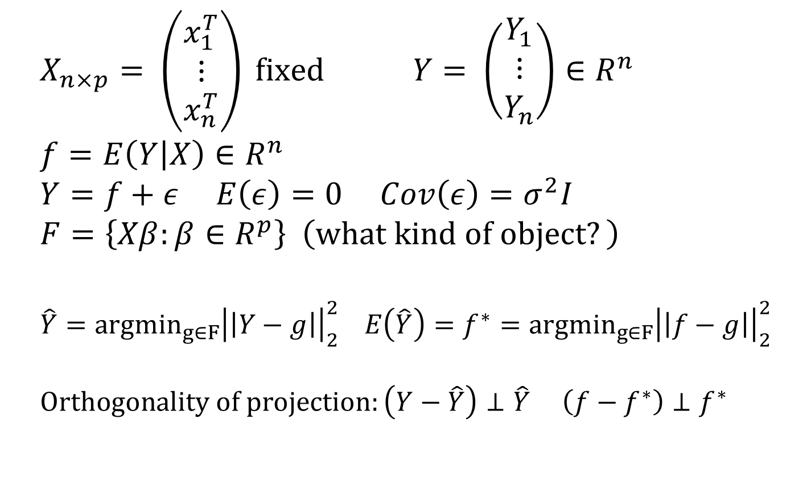
Setup for linear regression model
$$X_{n×p}= \left(\begin{matrix}x_{1}^{T} \\ ⋮ \\ x_{n}^{T}\end{matrix}\right) fixed Y= \left(\begin{matrix}Y_{1} \\ ⋮ \\ Y_{n}\end{matrix}\right)∈R^{n} \\ f=E\left(Y | X\right)∈R^{n} \\ Y=f+ε E\left(ε\right)=0 Cov\left(ε\right)=σ^{2}I \\ F=\left\{Xβ:β∈R^{p}\right\} \left(what kind of object?\right) \\ \hat{Y}=argmin_{g∈F}{\left|\left|Y−g\right|\right|}_{2}^{2} E\left(\hat{Y}\right)=f^{∗}=argmin_{g∈F}{\left|\left|f−g\right|\right|}_{2}^{2} \\ Orthogonality of projection:\left(Y−\hat{Y}\right)⊥\hat{Y} \left(f−f^{∗}\right)⊥f^{∗}$$

Slide 2
Analyzing “EPE” (fixed X)
0 (independence)
0
=σ² (irreducible)
bias²
variance (= σ²p/n)

Slide 3
Graphical picture of linear model
F
Data variance
y
Variance
ƒ
Bias
Irreducible error
y_{new}

Slide 4
Regularization in linear regression
Questions:
  What happens to our bias?
  What happens to our variance?
  What happens to our calculations (still orthogonal projections?)

Slide 5
Graphical picture of linear model + regularization
F
F
Data variance
Model variance
F_{c}
y
Variance
ƒ
Bias
Irreducible error
y_{new}

